Slide 1
BallotOnline Training Presentation
Trent J. Broderick

Slide 2
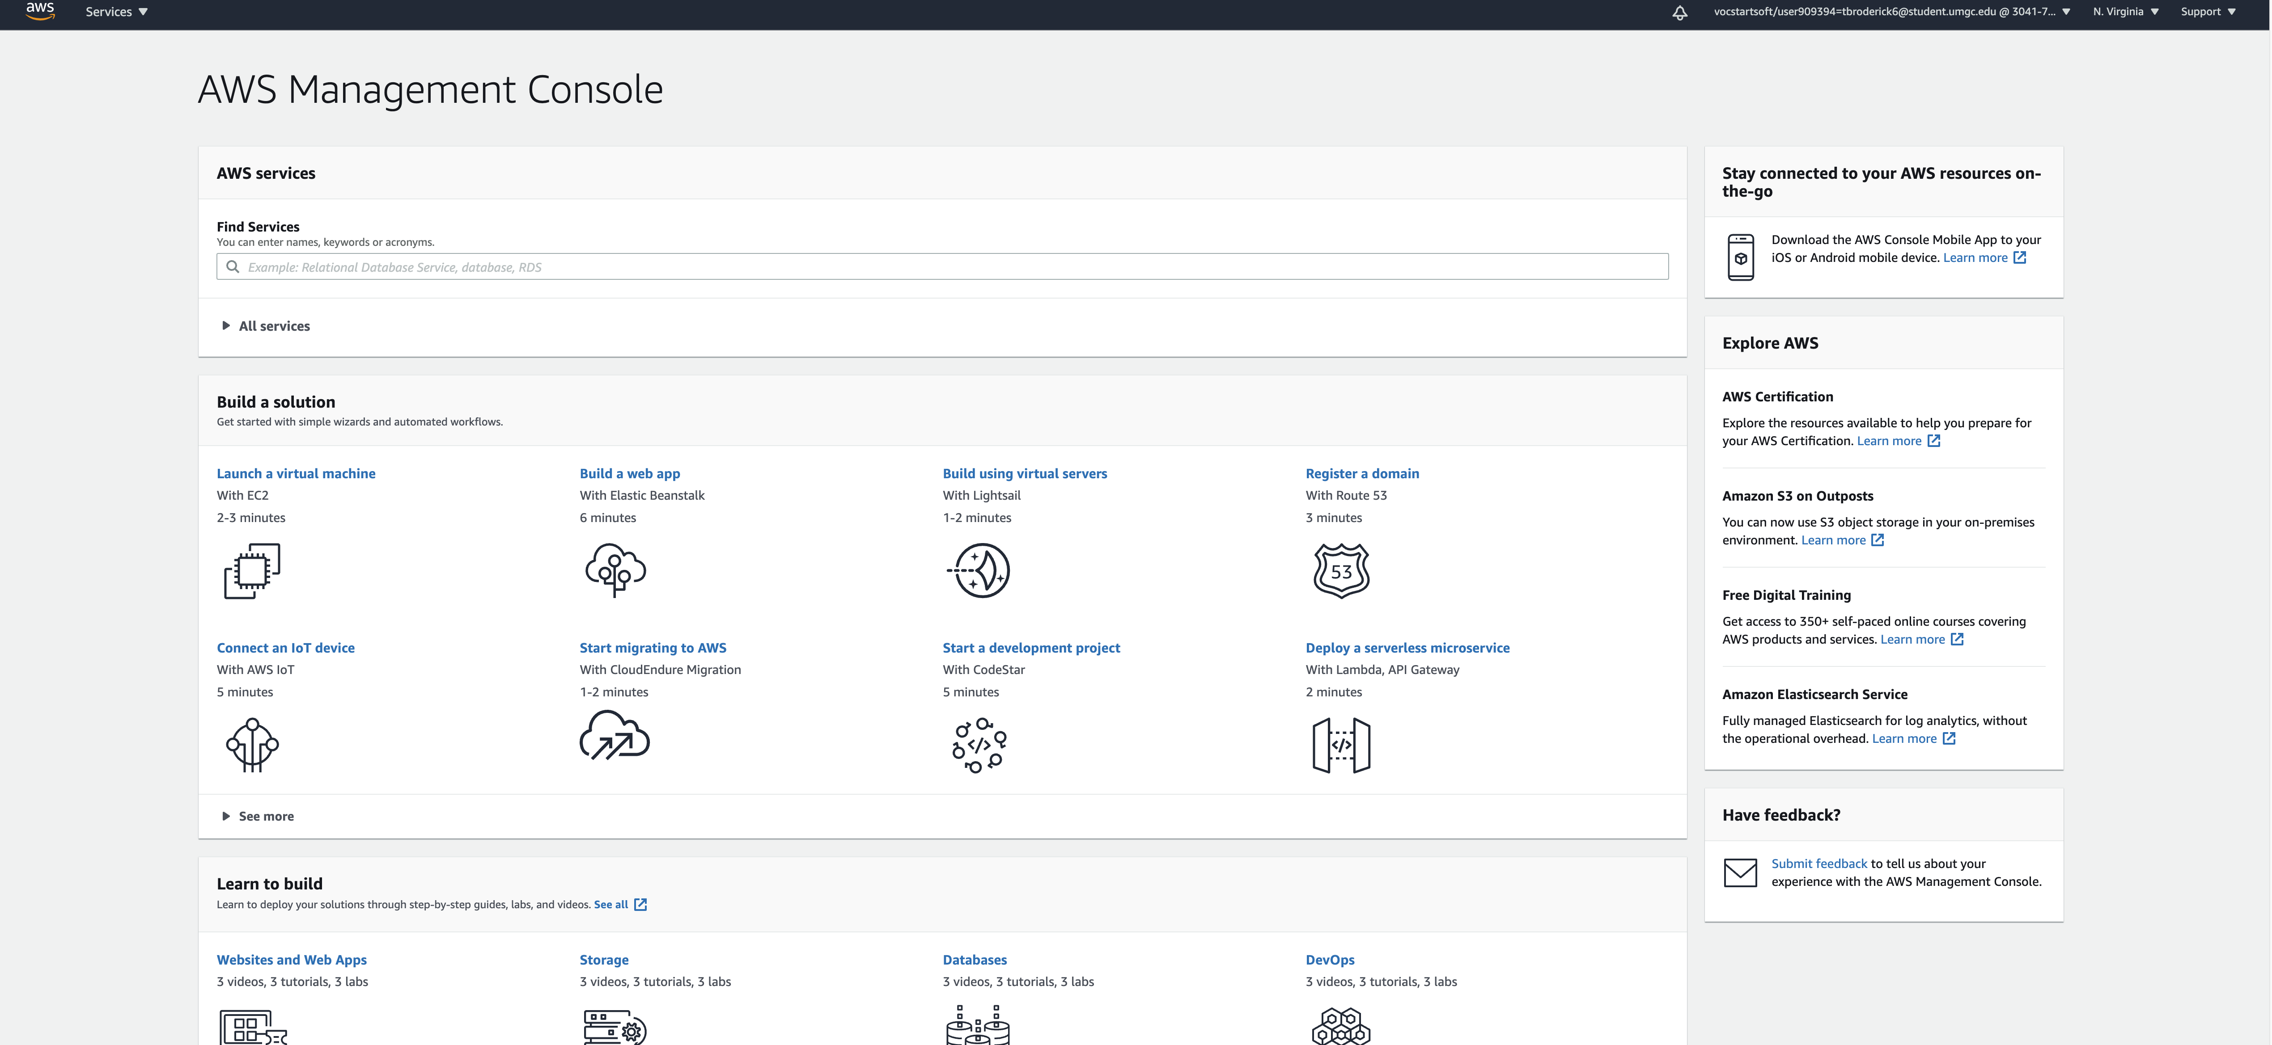
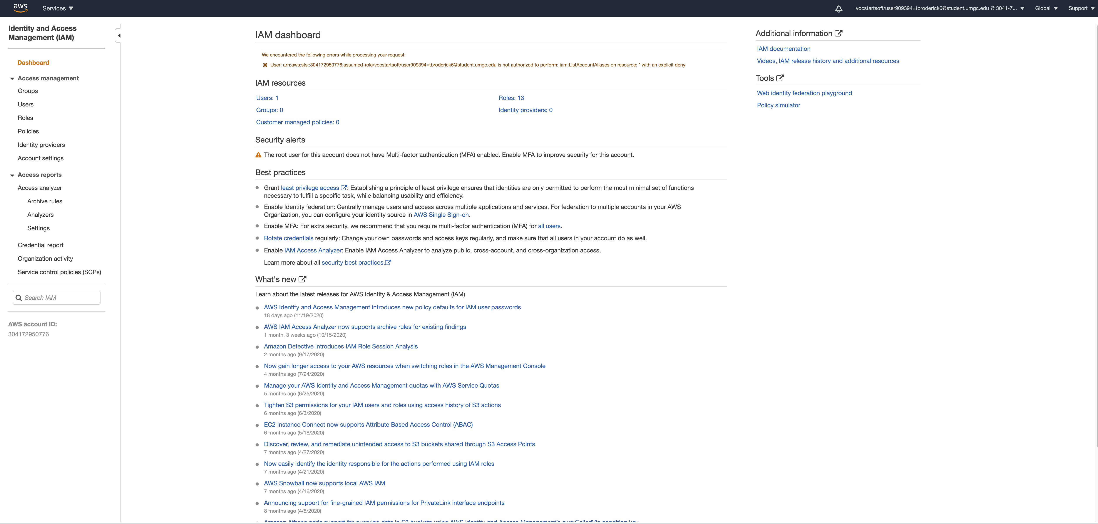
Creating IAM Groups and Adding Users
From the AWS Console, in the search bar, type in IAM and select IAM
Notes:
What is IAM?
Identity Access Management is how Amazon approaches setting permissions to resources for a certain individual or set of individuals (Amazon). Each cloud project manager should create an IAM group for their team to manage both administration of the users as well as cost control protections. In this example, I will show you how to set up an IAM Group, configure IAM policies and leverage the service catalog to control the resources for the Backup and Archiving project.

Slide 3
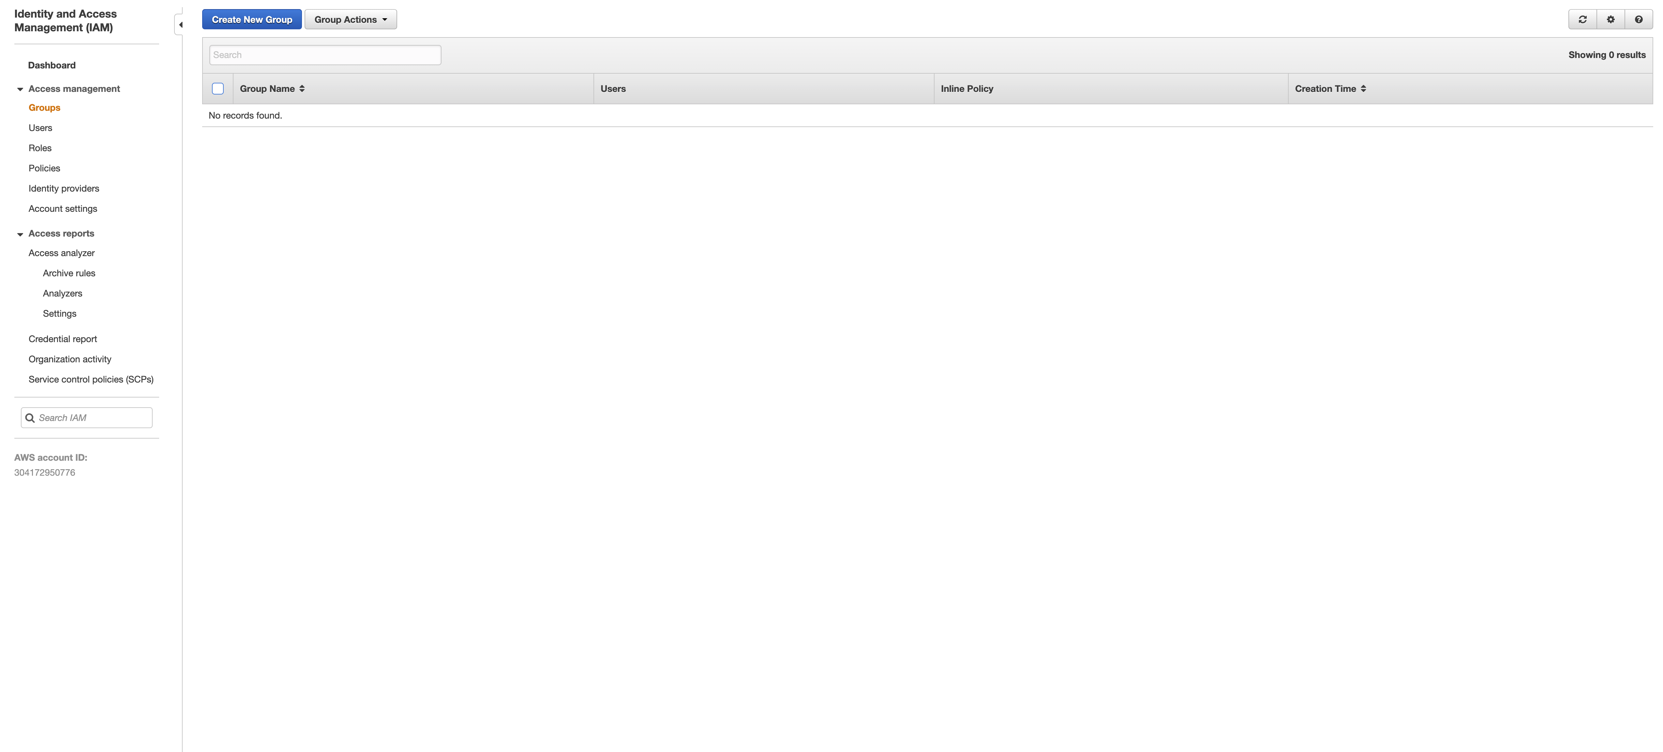
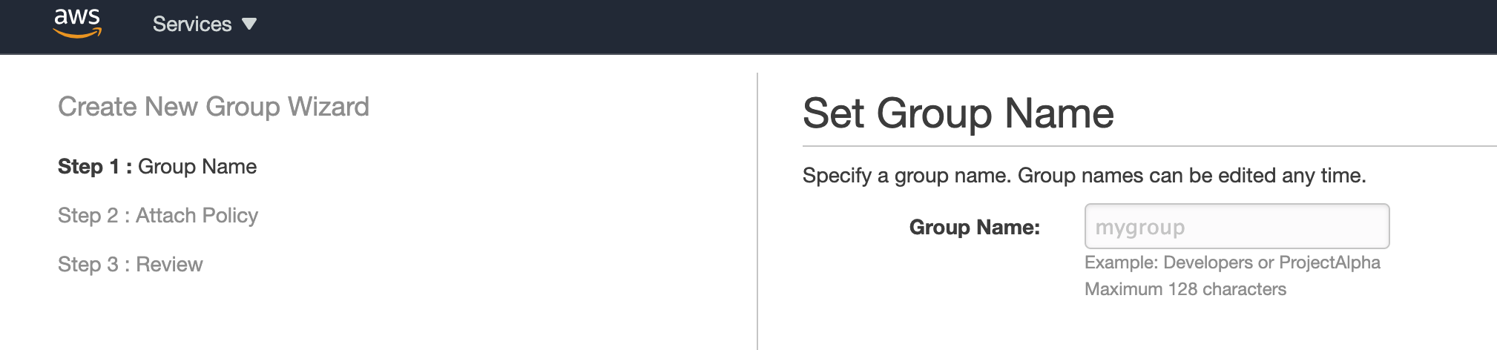
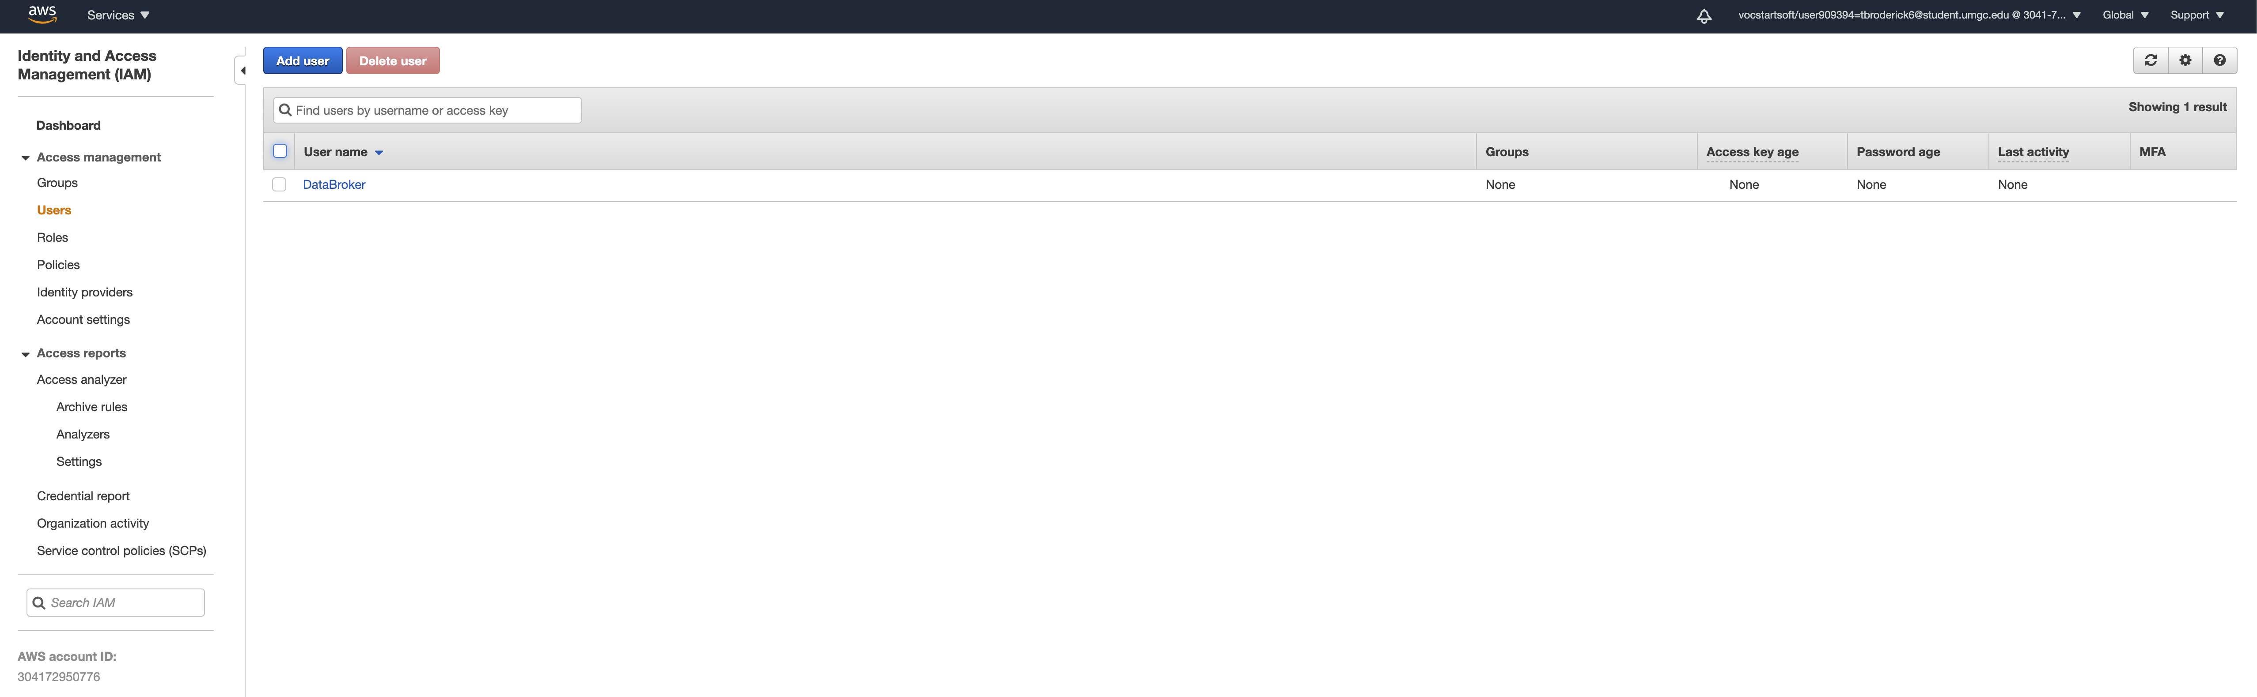
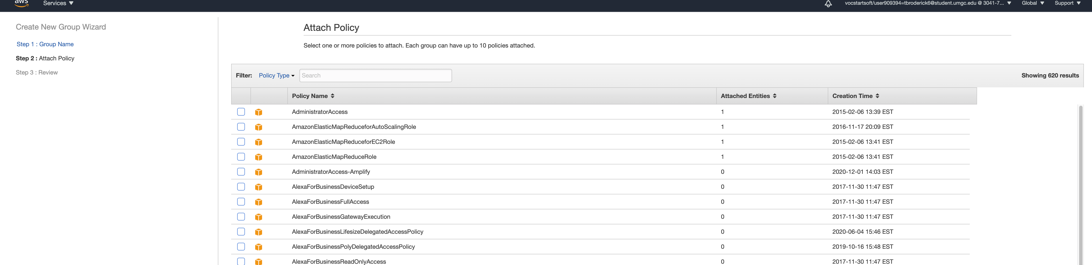
Select Groups, Create New Group and fill out the information accordingly. Group Name -> Attach Policies -> Review -> Create Group
When Choosing Policies, keep in mind who the group is and their job when interacting with the AWS Console. What access DO they need? What access DON’T they need?
Notes:
When navigating into the IAM Console, start by creating a group. The groups name for this project is Backup Operators. In Attach Policy, make sure to pick policies relevant to the project. In this case, I gave this group Full S3 Access to deploy additional S3 buckets and remove them as needed, and End User Service Catalog Access so the end user can deploy the service catalog that I have configured for them. Next, review then create the group.

Slide 4
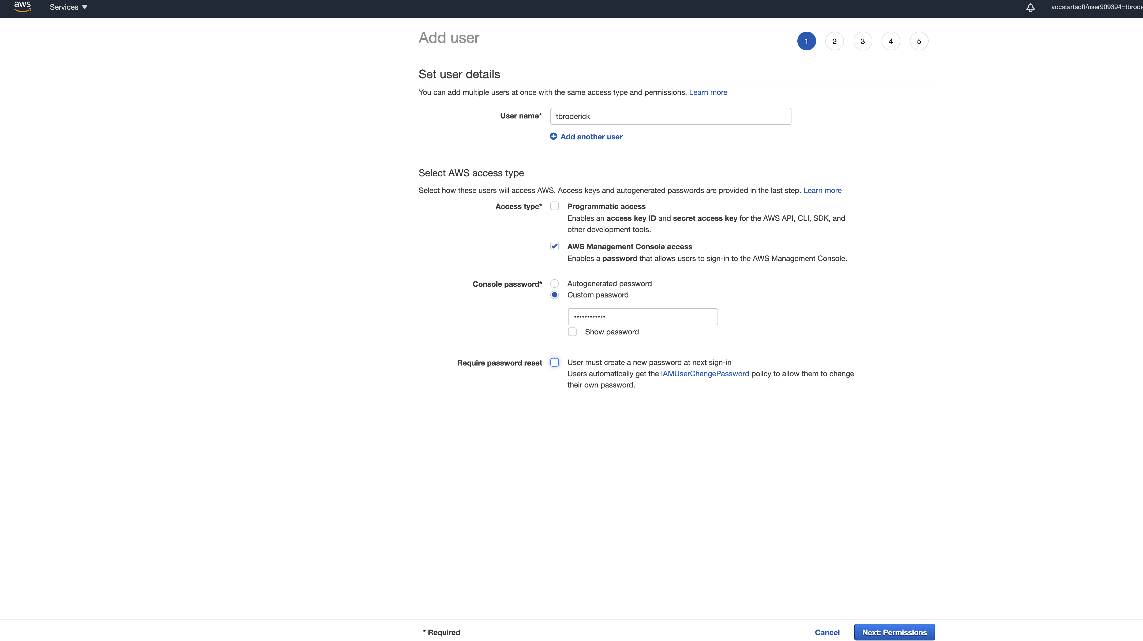
Adding Users to IAM Groups
Click on Users from the menu on the right, Add Users, then fill out the information appropriately.
Create User -> Add as many users as needed -> Access Levels -> Add Password -> Next
Notes:
Now it is time to add users to the newly created group. Create usernames, the BallotOnline standard will be first initial and last name. In the event it is taken, first and last name will work as well. Please note that you do not need to do this one by one, you can add multiple users at a time. Next, set the user to AWS Management Console and ser a custom password “BallotOnline123” and set the Require Password Reset button. Then, we will set the Permissions.

Slide 5
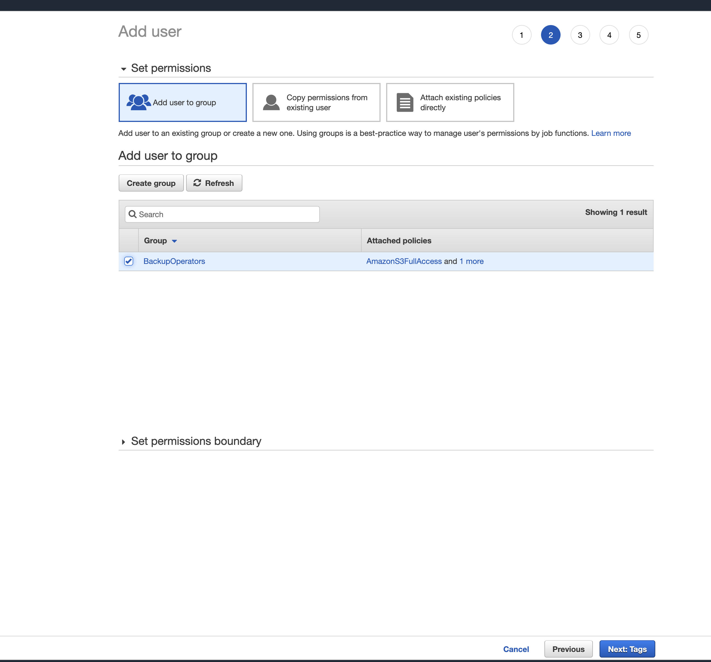
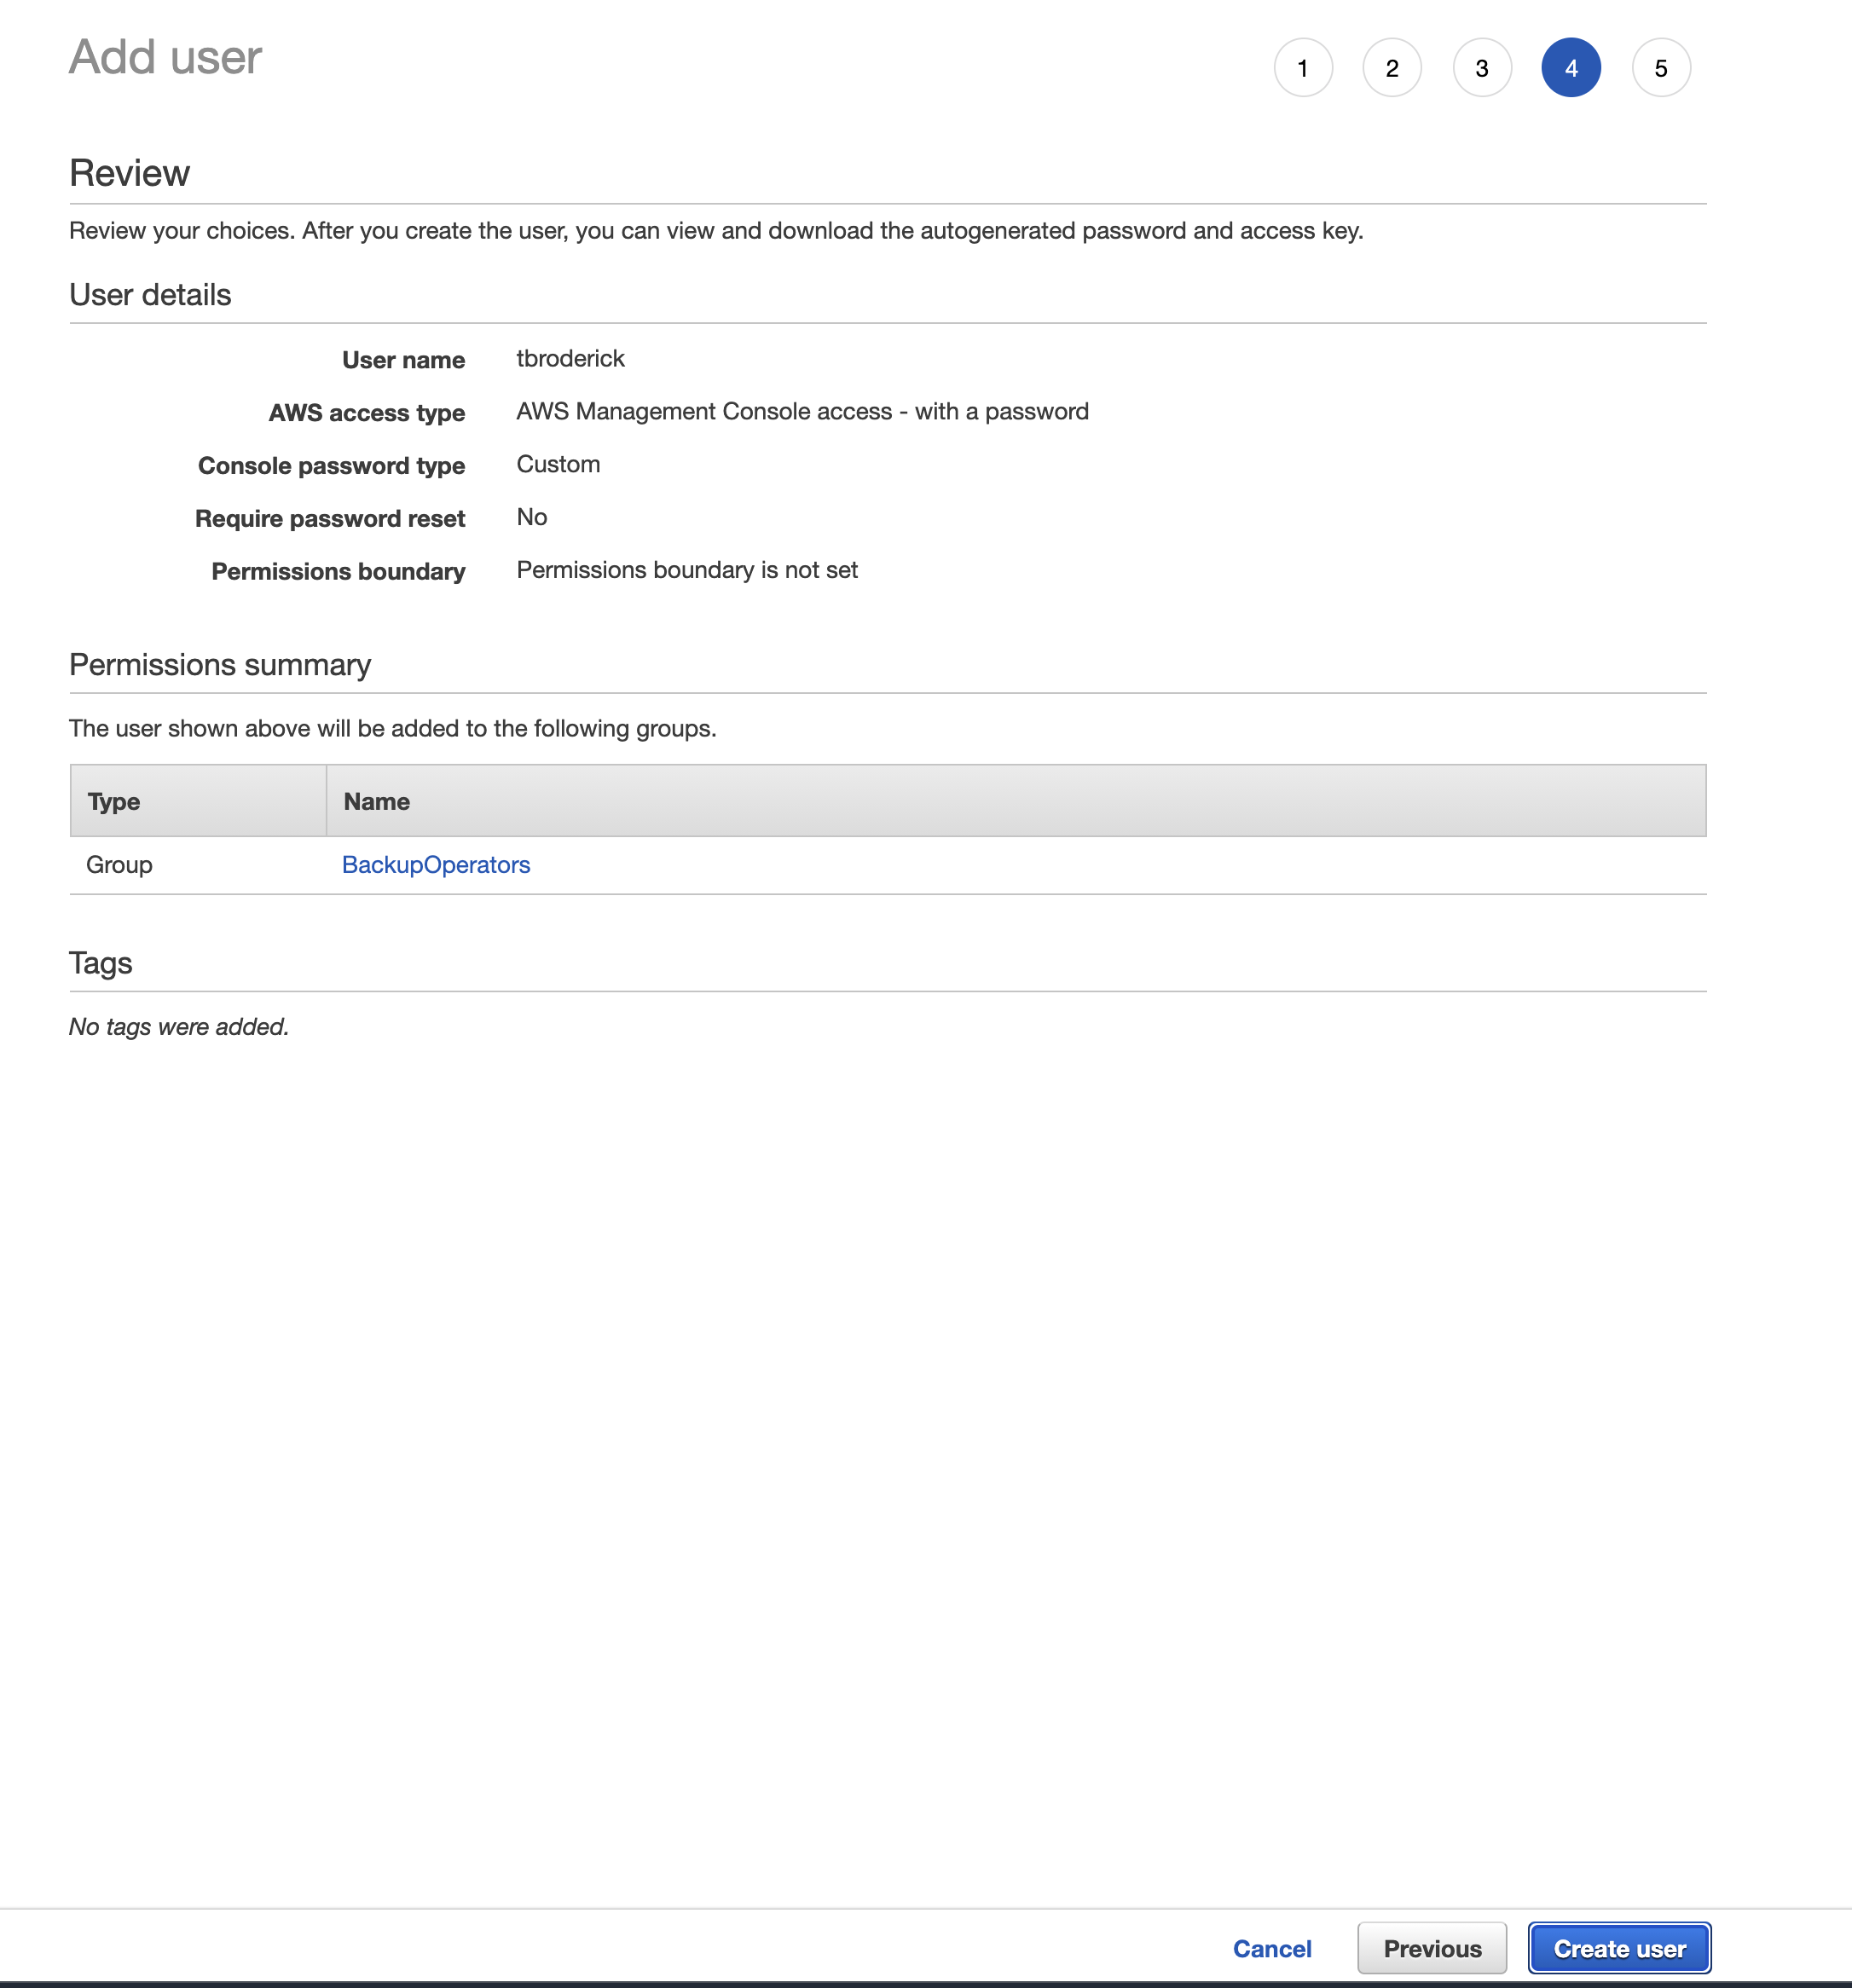
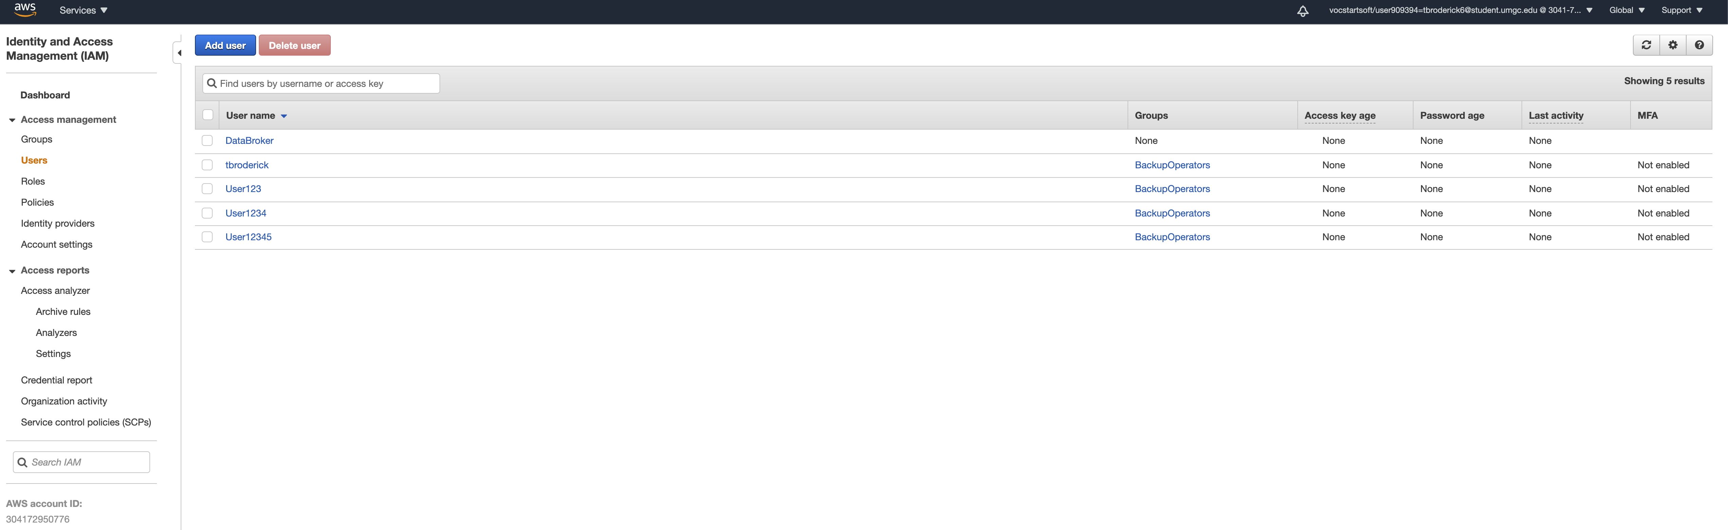
Add The Users to the created IAM Group -> Tag as needed -> Review -> Create User(s)
Notes:
When setting permissions, please use the group previously created and add users to that group. There is no need for tagging as of today, this may be updated in the future. Next, review and create and you will see all of your users populate. You will want to share the Account ID or IAM sign in link with the users so they can access the AWS Console.

Slide 6
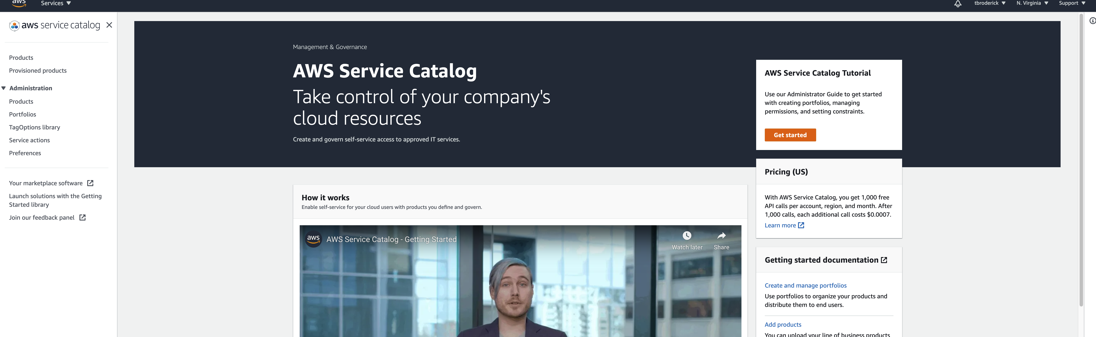
Leveraging Service Catalog
From the AWS Console, search for Service catalog and select the Service Catalog Option. Click Get Started. If not automatically directed, select Portfolios on the right Menu and Create a Portfolio.
Notes:
Welcome to the Service Catalog! The service catalog allows Admin users to pre-set resources a particular group or groups of IAM users can deploy (amazon). The service catalog is perfect for admin users to predetermine needed resources for a project to ensure there is no overspending, overprovisioning and the resources are preconfigured to save time for the end users to get right to work.

Slide 7
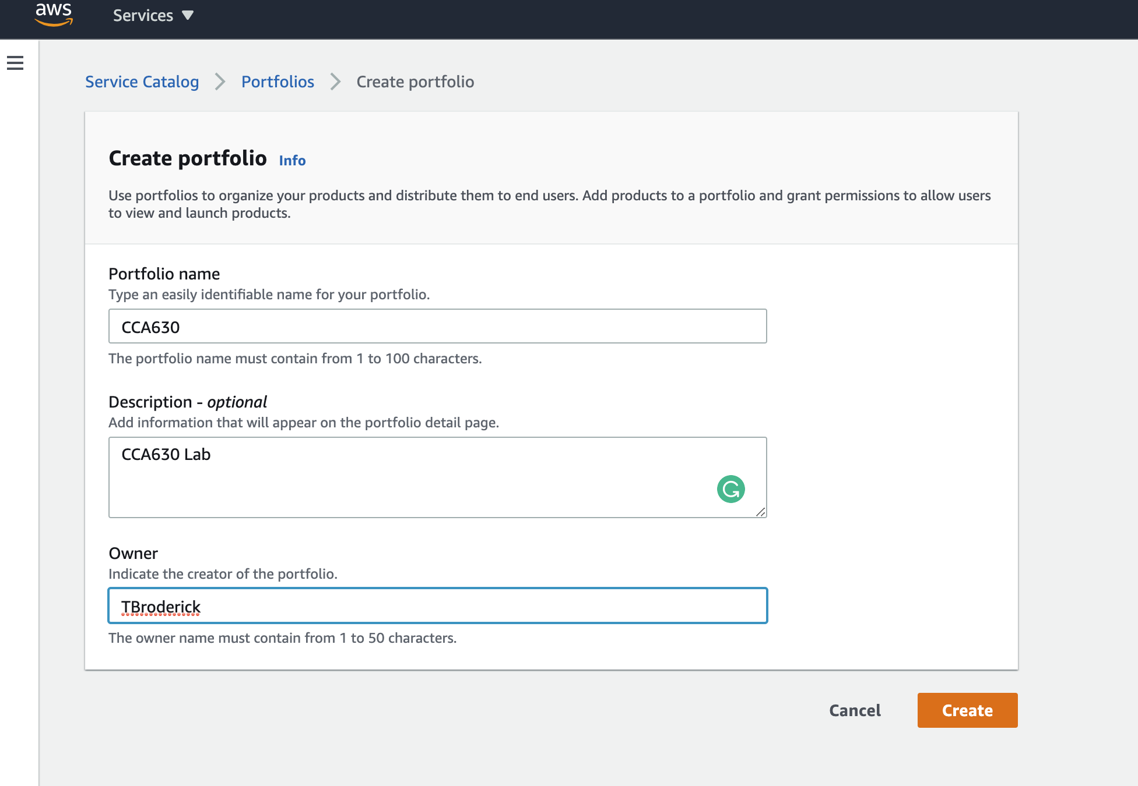
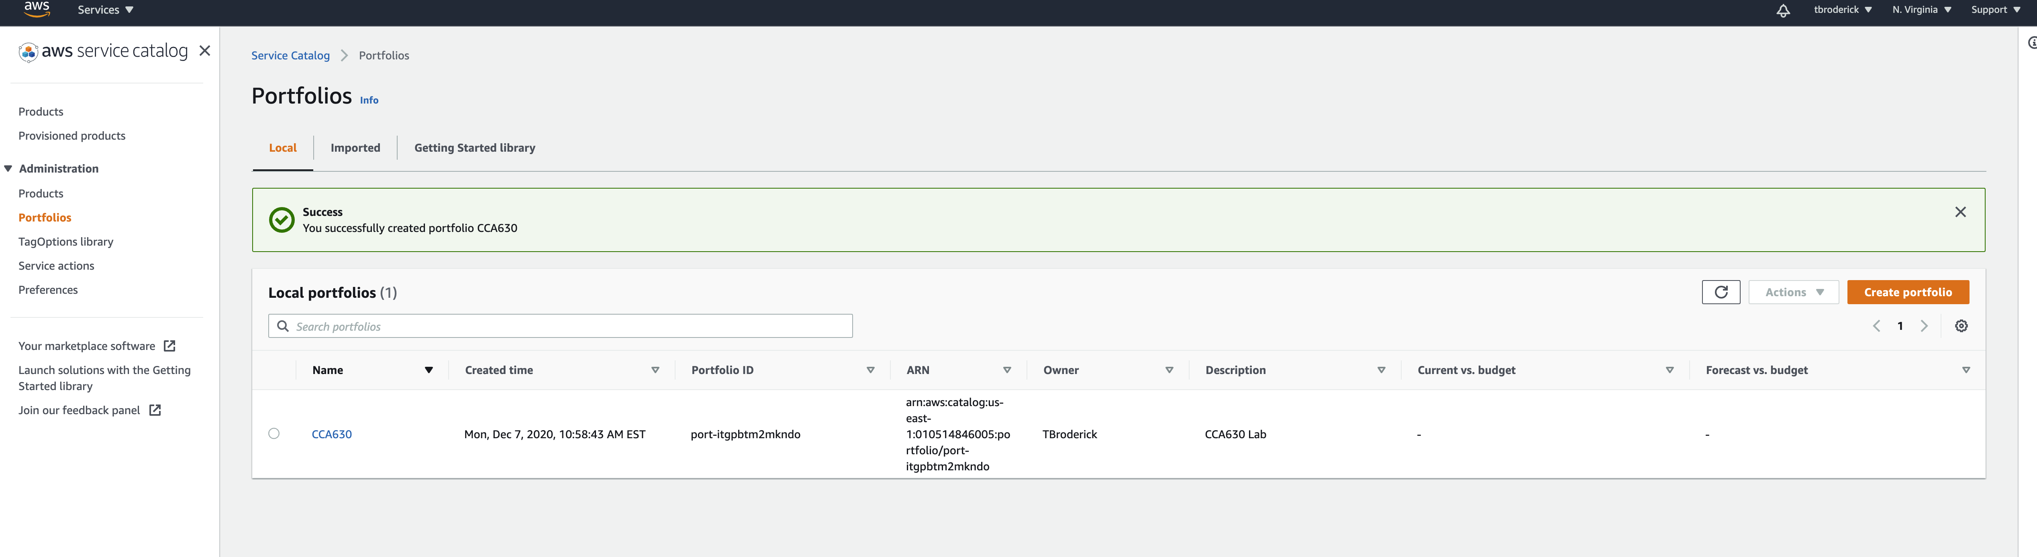
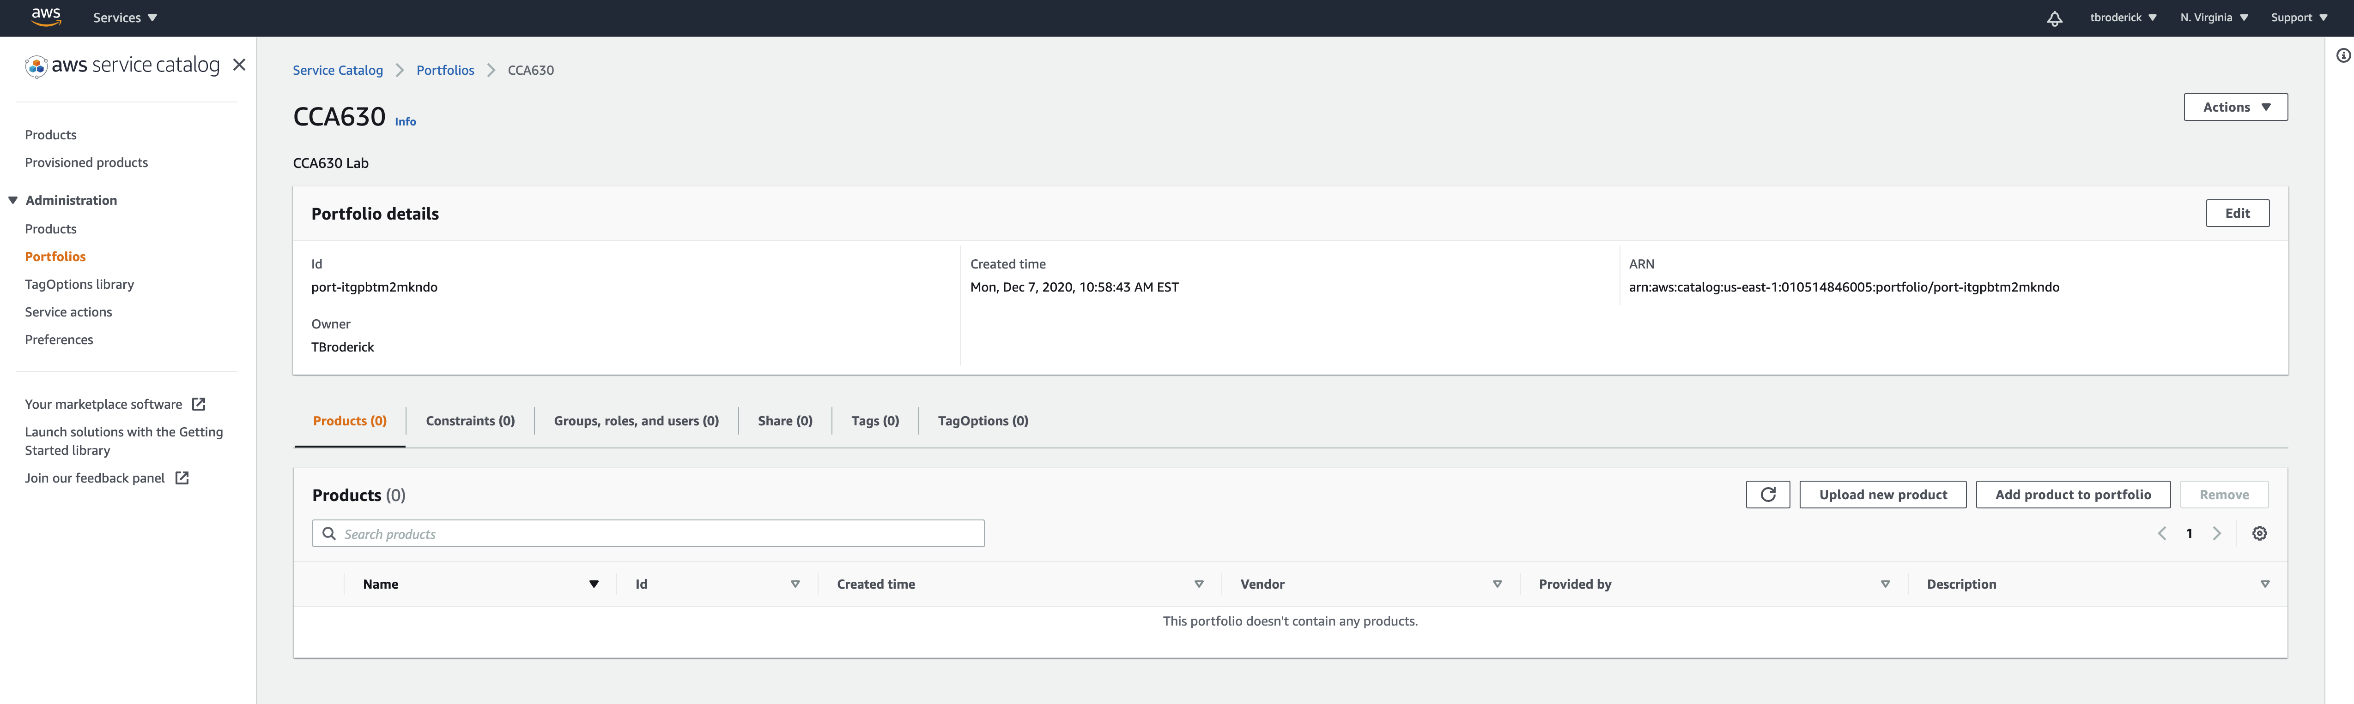
Fill out the information for the Portfolio as needed and Click create. From there, click on the name of the new portfolio to access it. Click Upload New Product to continue.
Notes:
We need to create a portfolio first so we can add in the groups we created earlier as well as the products they will be able to access. Create an easy-to-understand name and description. The owner should be the project manager. Once the information is entered, press create. From there, click on your portfolio name to enter the management console.

Slide 8
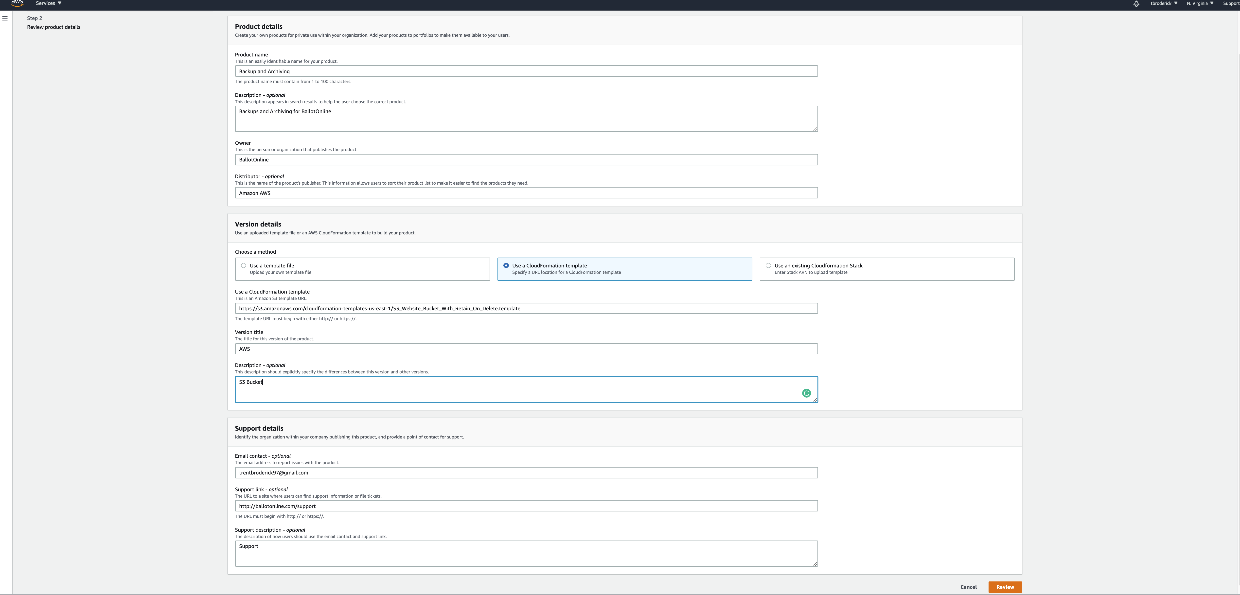
Fill out the product details, ensure there is a portfolio version (cloudformation template) and the details for the support team are listed as well.
Notes:
Navigate to the product tab and click create product. On this screen, the product name should be the name of the project. Again, the Owner must be the project manager. The project manager is expected to have a preconfigured cloudformation template saved that can be uploaded into the product console as shown here. The Version File can be AWS, but the description must include the products in the cloudformation template. For support, please ensure our support teams information has been included here.

Slide 9
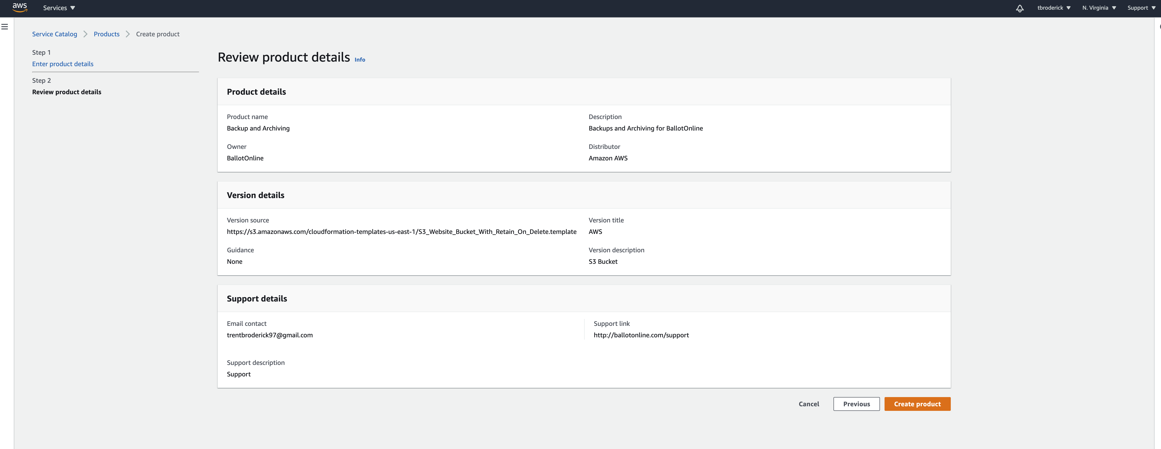
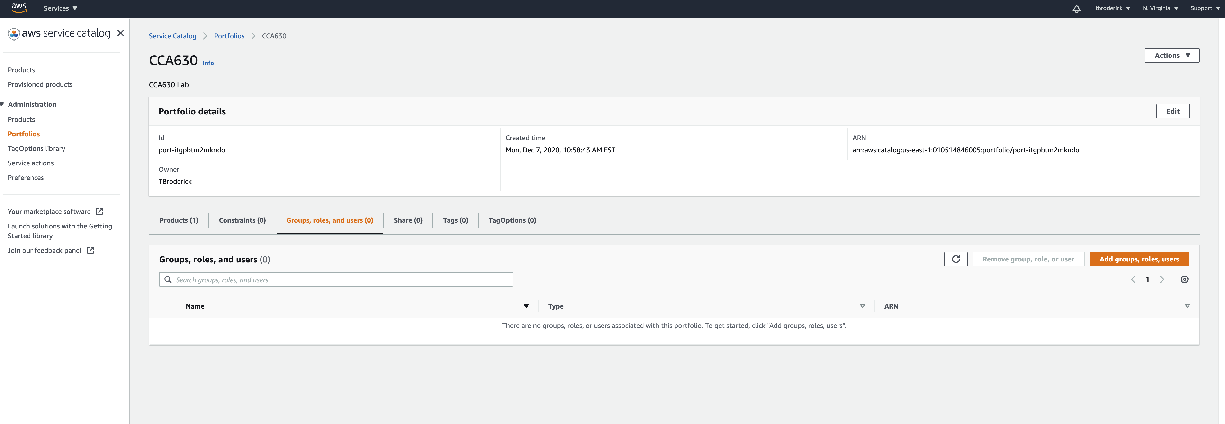
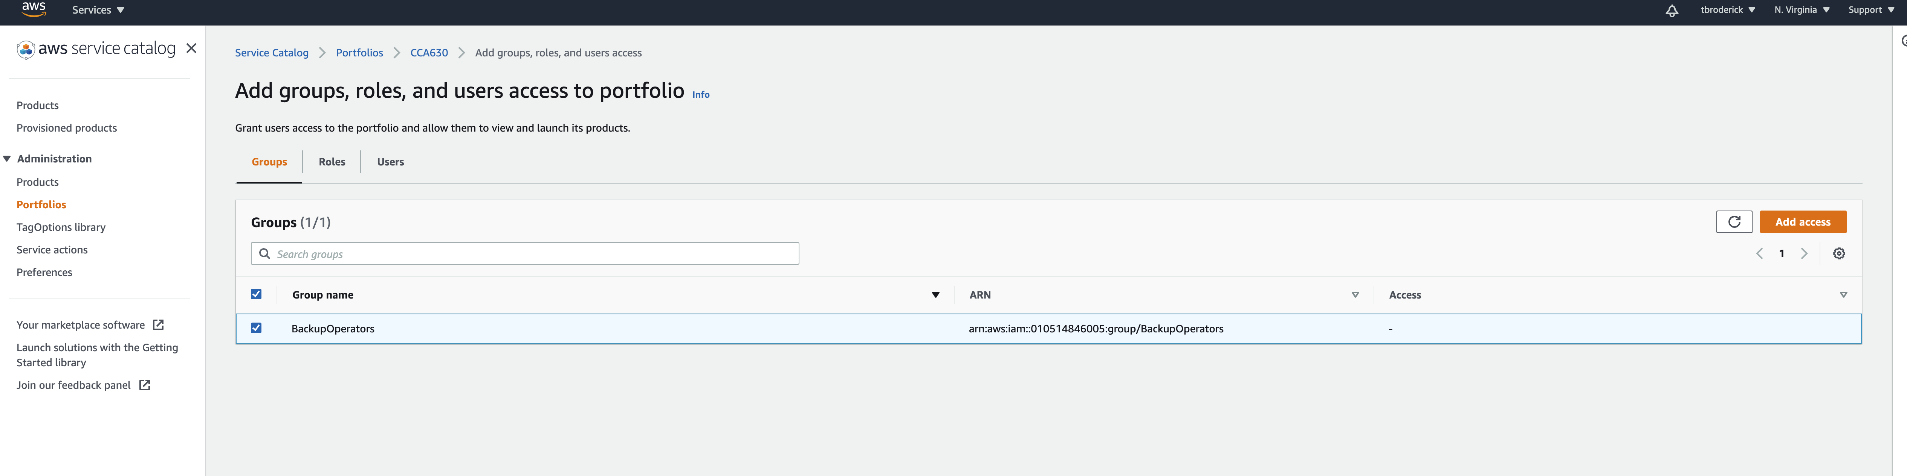
Click Create on the Review page. After, navigate to the Groups Tab and add the IAM group we created earlier.
Notes:
Once reviewed, click create then navigate to the Groups tab and click on Add Group. This will open a drop menu for you to add our newly created group into the portfolio. Once selected press add.

Slide 10
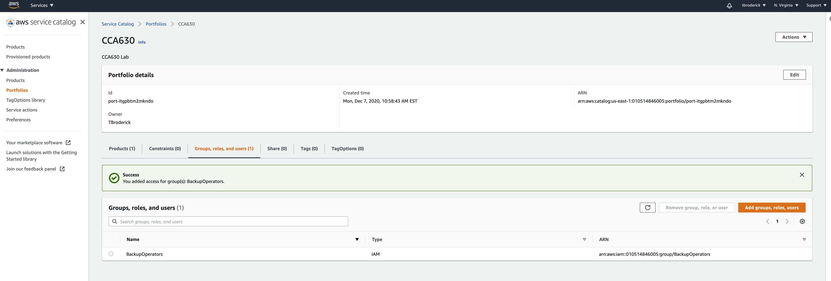
SUCCESS!
Notes:
Now that the service catalog is set up, the Users can deploy the resources you have allocated for them for a particular project. Everything that has been configured here is now an actionable resource for the end user. Please share the user ids / logins with your IAM users so they can get to work immediately.

Slide 11
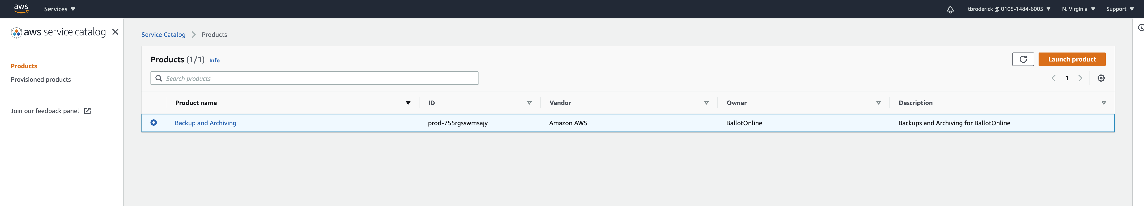
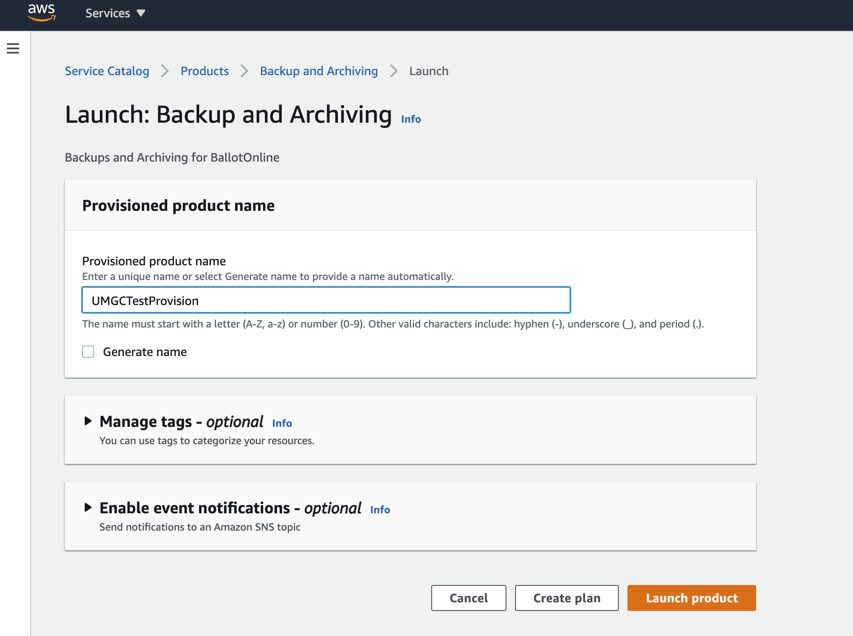
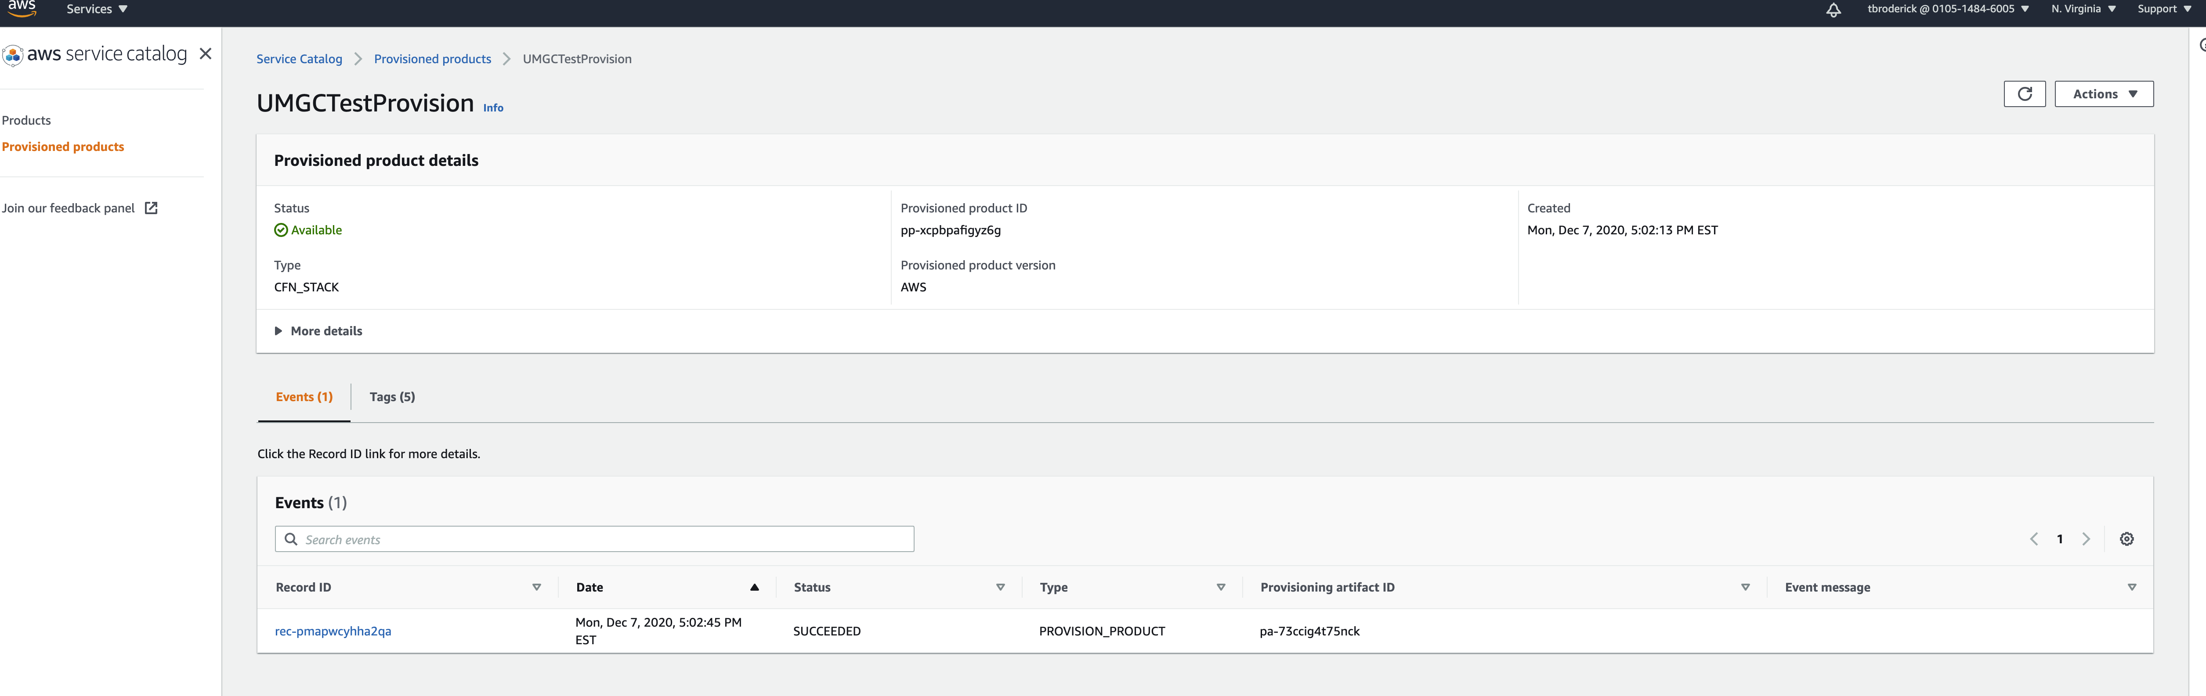
End User Instruction
Enter the AWS Console –> Search for Service Catalog -> Click on products on the left menu -> Launch Product
Notes:
Once you have been provided your Account ID / Log in link from your project lead, please search for Service Catalog in the AWS Console. You will see under products, a product you can launch. Select it, and press launch product. Please name the products as related to the project or with the project names, skip tagging for now and add notifications if instructed by project manager then press launch. The following screen will alert you when the products have been provisioned. When provisioned, you can click into the products to view more details on what was provisioned. Any questions or issues related to products should be directed to your project manager.

Slide 12
References
Amazon. (2020a). AWS IAM Overview. Amazon Web Services, Inc. https://aws.amazon.com/iam/
Amazon. (2020b). AWS Service Catalog Features - Amazon Web Services. Amazon Web Services, Inc. https://aws.amazon.com/servicecatalog/features/
Amazon. (2020c). Identity and Access Management in AWS Service Catalog - AWS Service Catalog. https://docs.aws.amazon.com/servicecatalog/latest/adminguide/controlling_access.html
Amazon. (2020d). Managing Portfolios - AWS Service Catalog. https://docs.aws.amazon.com/servicecatalog/latest/adminguide/catalogs_portfolios.html
Amazon. (2020e). Setting Up for AWS Service Catalog - AWS Service Catalog. https://docs.aws.amazon.com/servicecatalog/latest/adminguide/setup.html
Amazon. (2020f). What Is AWS Service Catalog? - AWS Service Catalog. Amazon Web Services. https://docs.aws.amazon.com/servicecatalog/latest/adminguide/introduction.html
UMGC. (2020). Deploy the Service Catalog. https://leocontent.umgc.edu/content/umuc/tgs/cca/cca630/2208/course-resource-list/deploy-the-service-catalog.html?ou=516113

